Slide 1
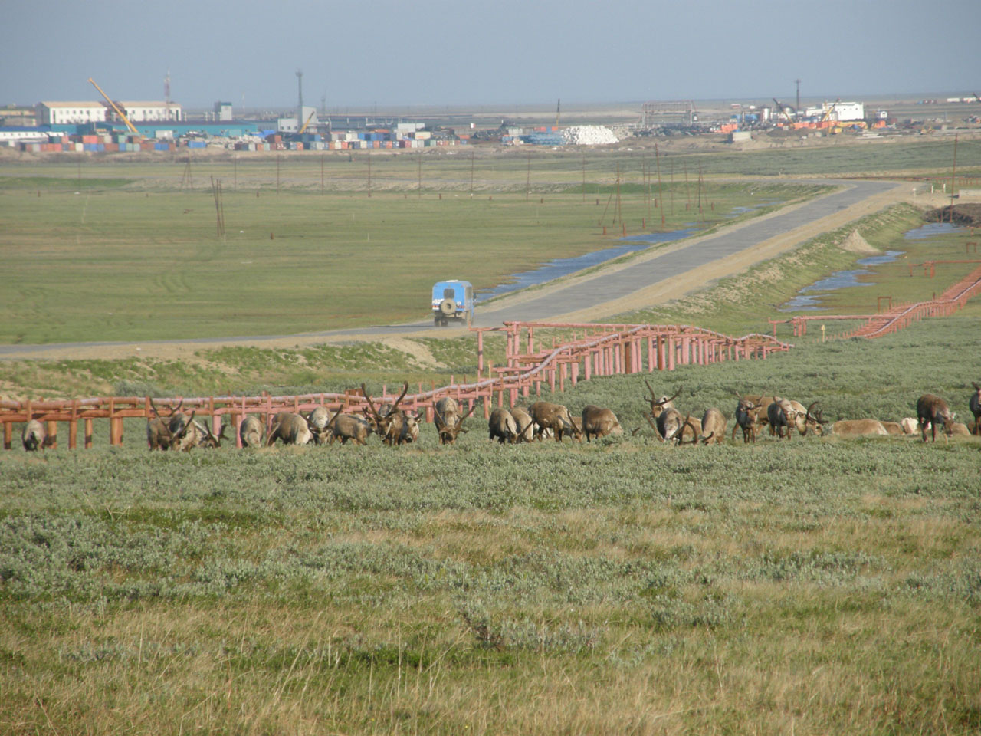
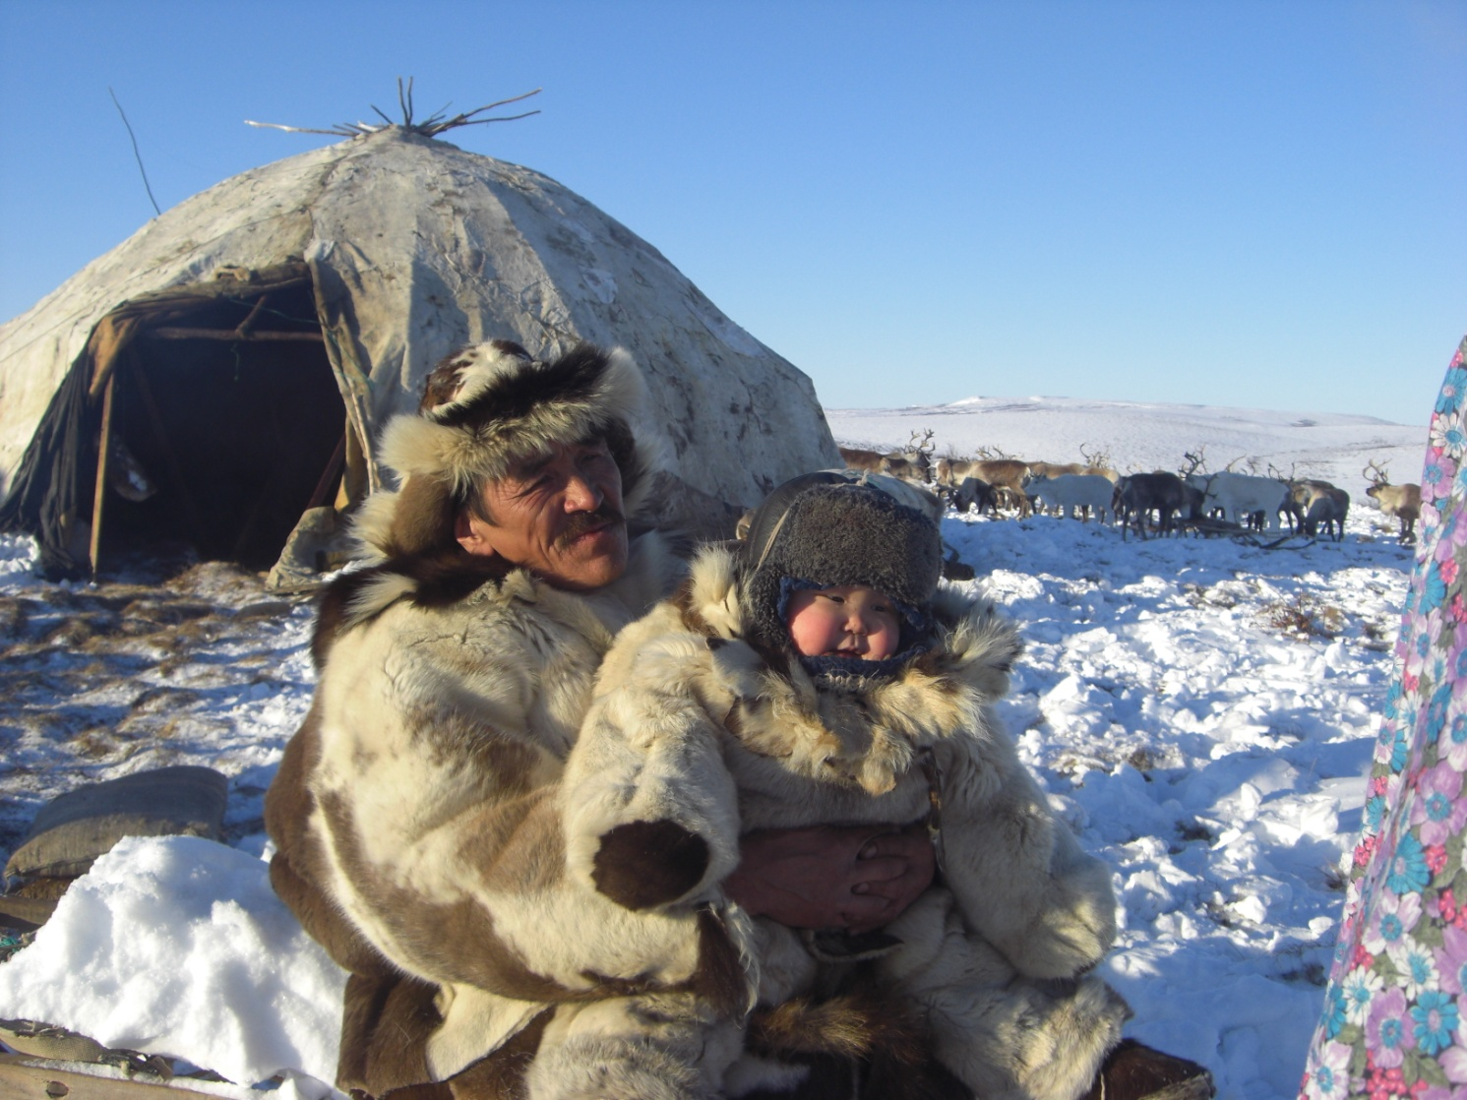
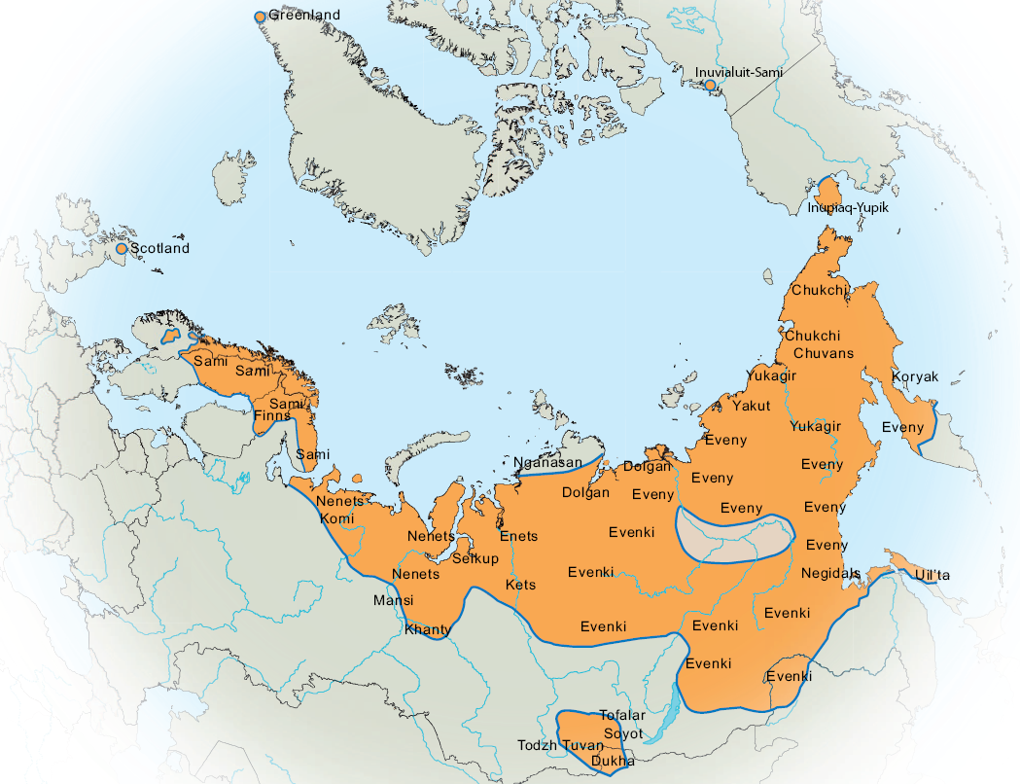
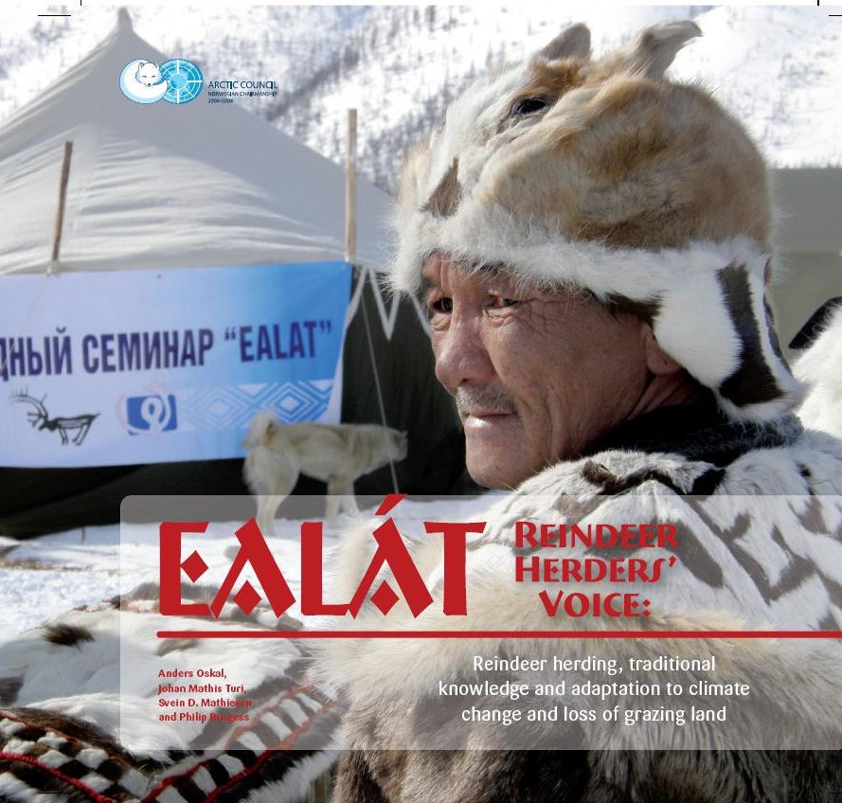
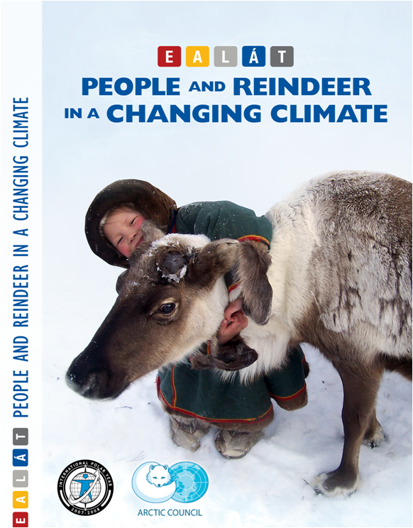
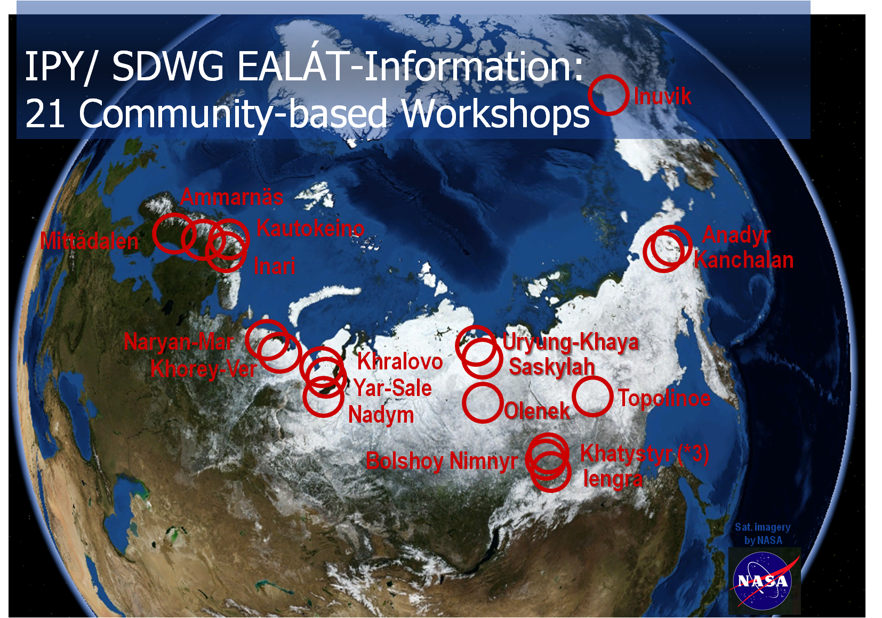
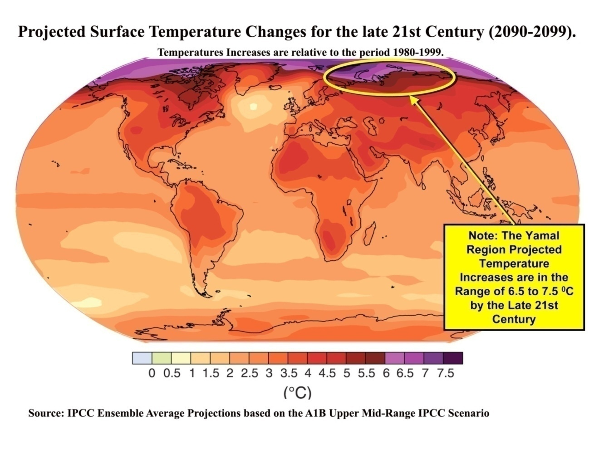
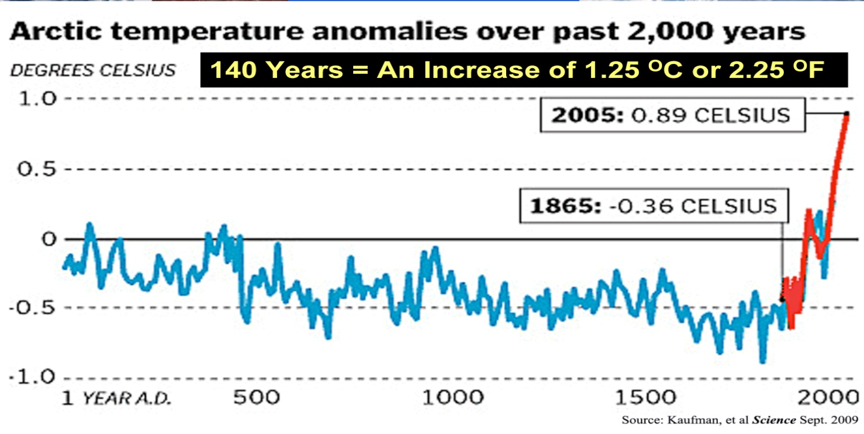
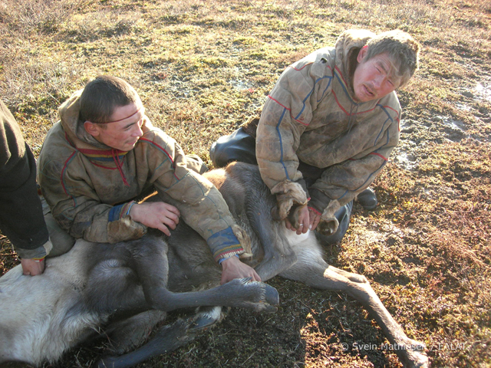
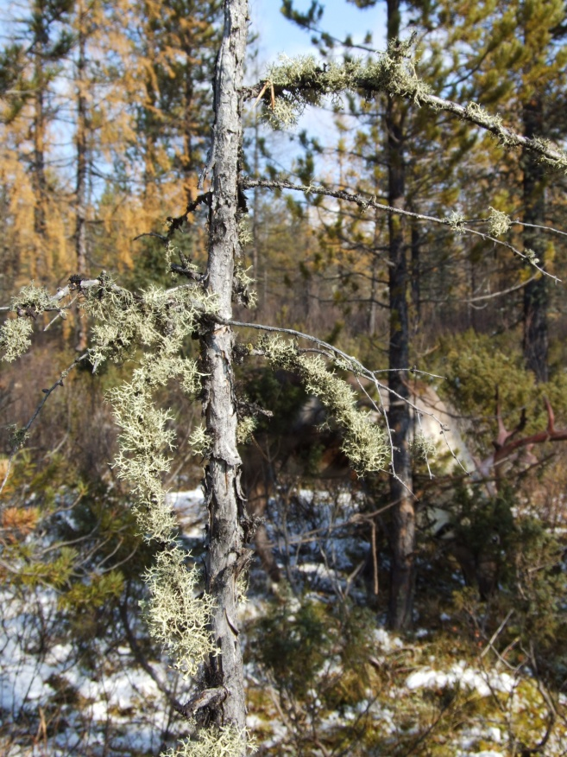
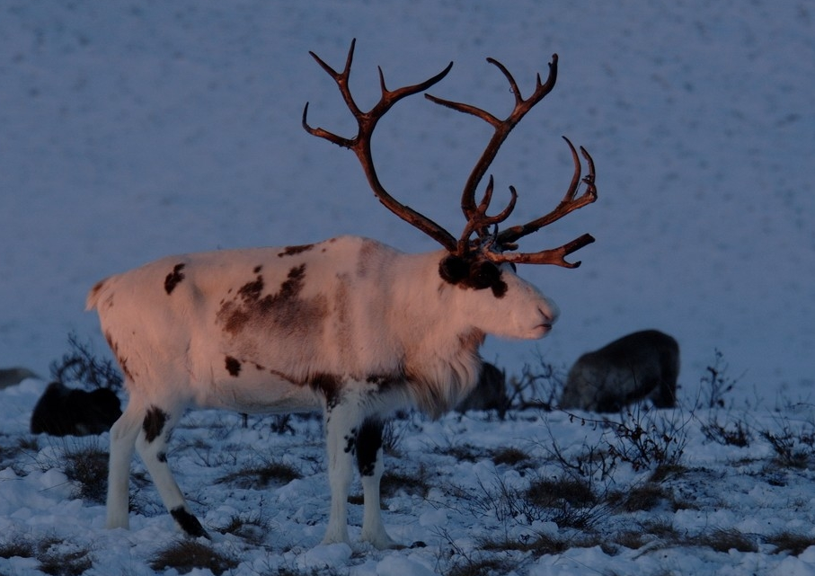
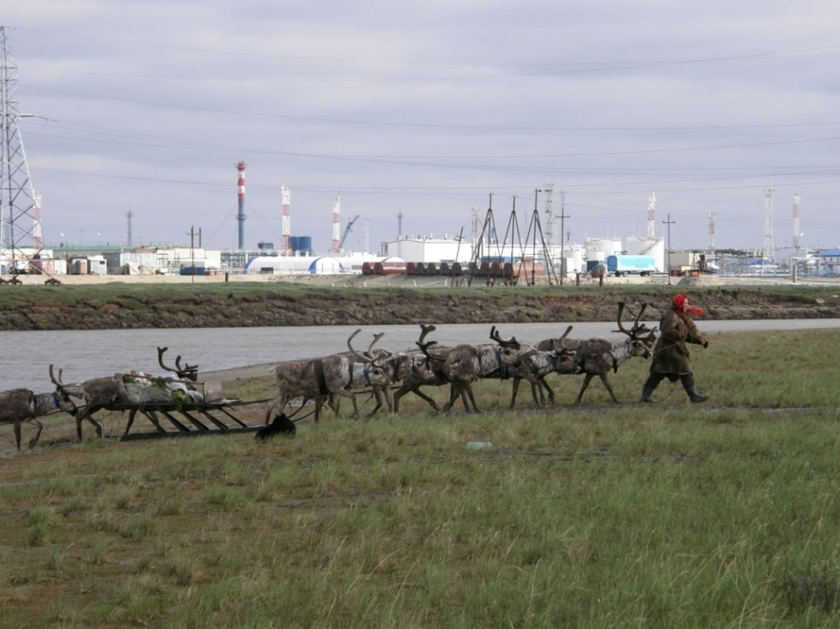
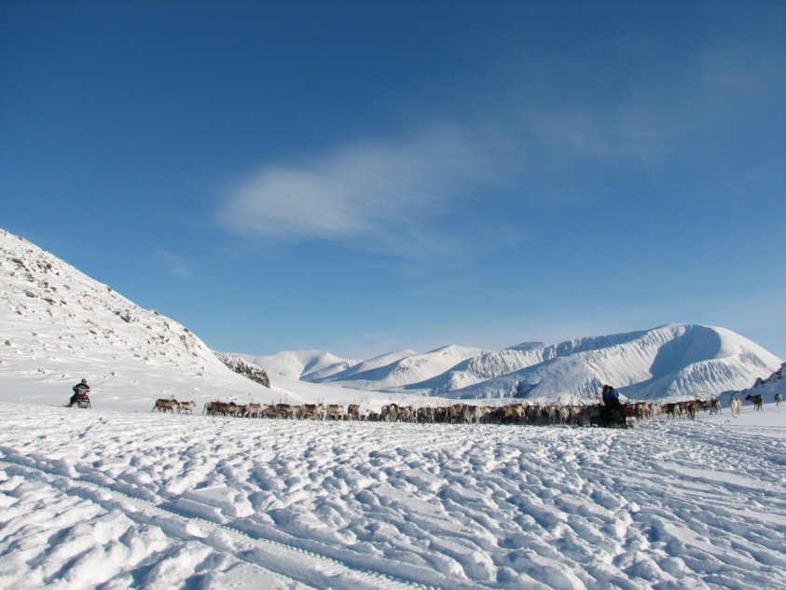
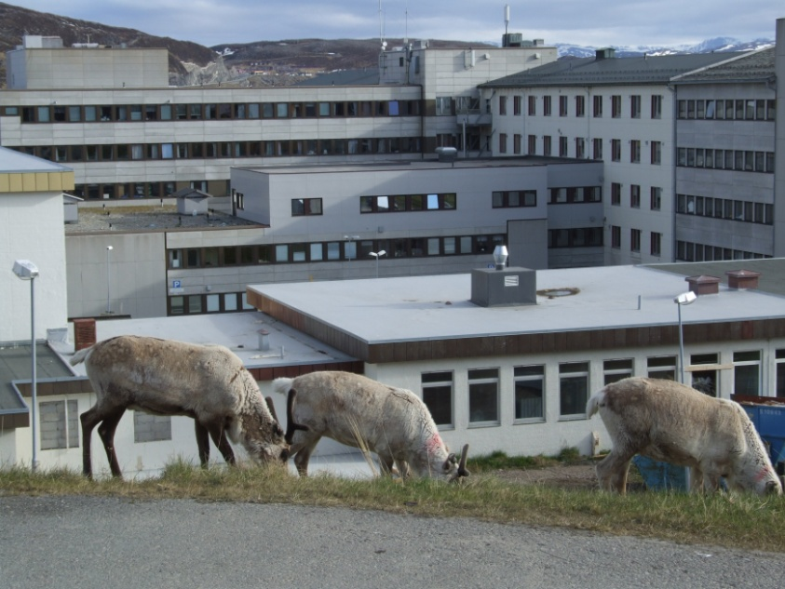
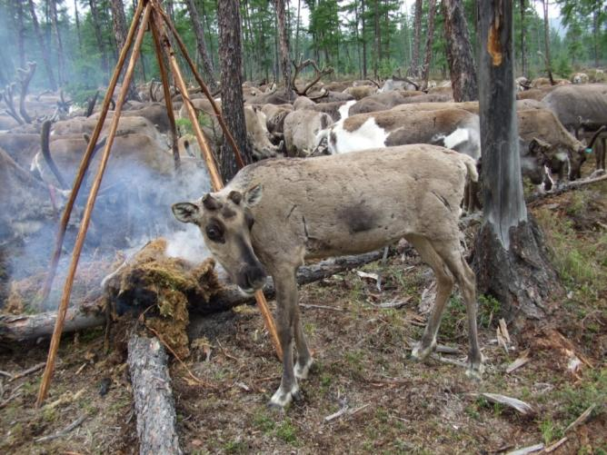
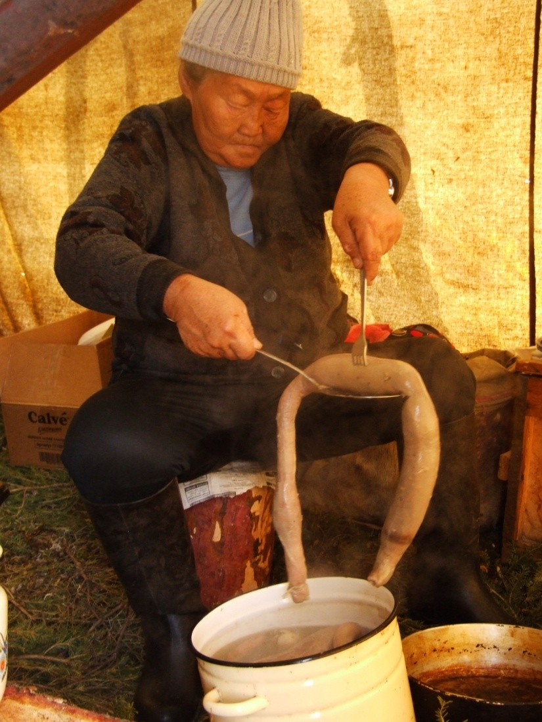
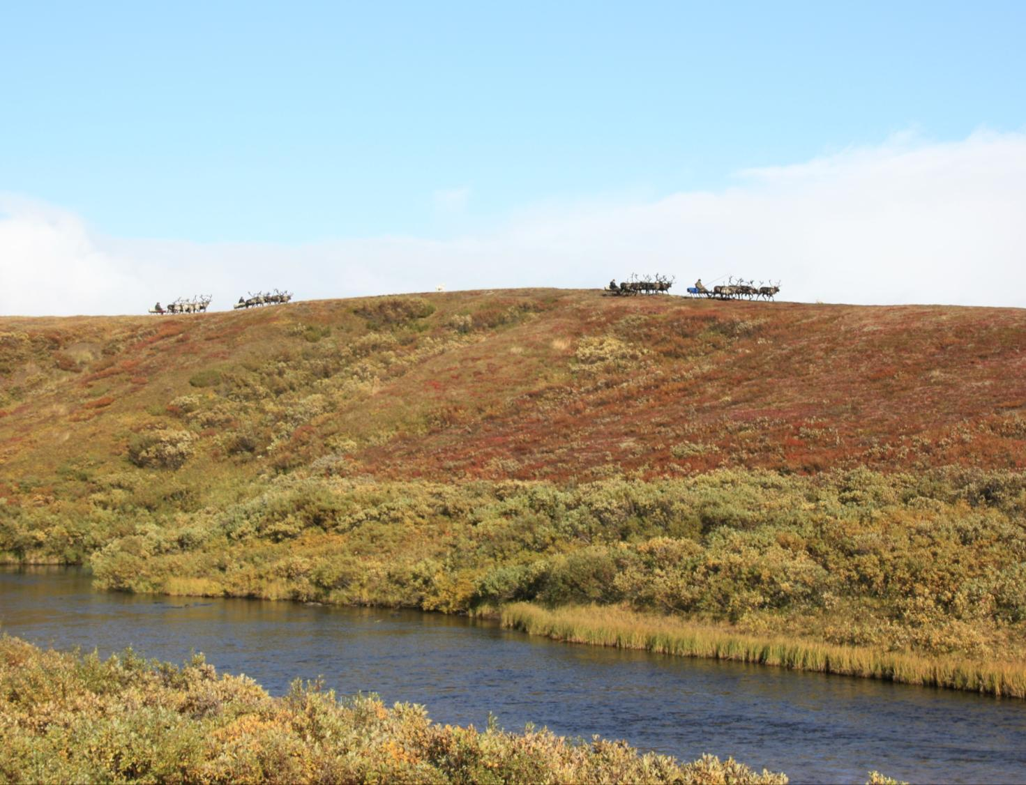
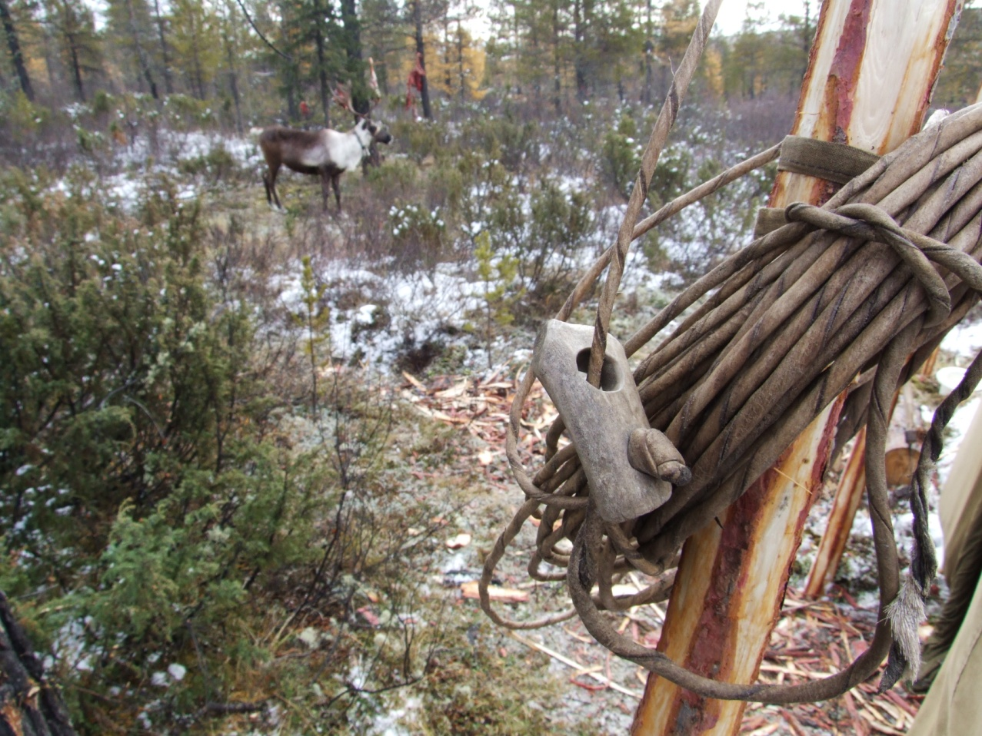
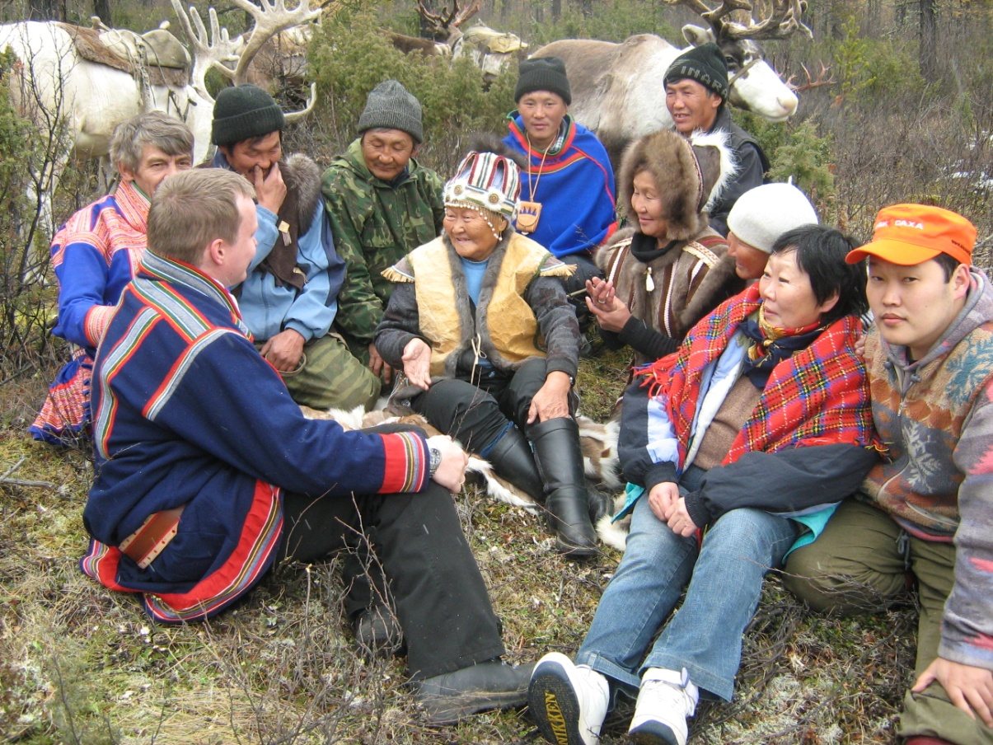
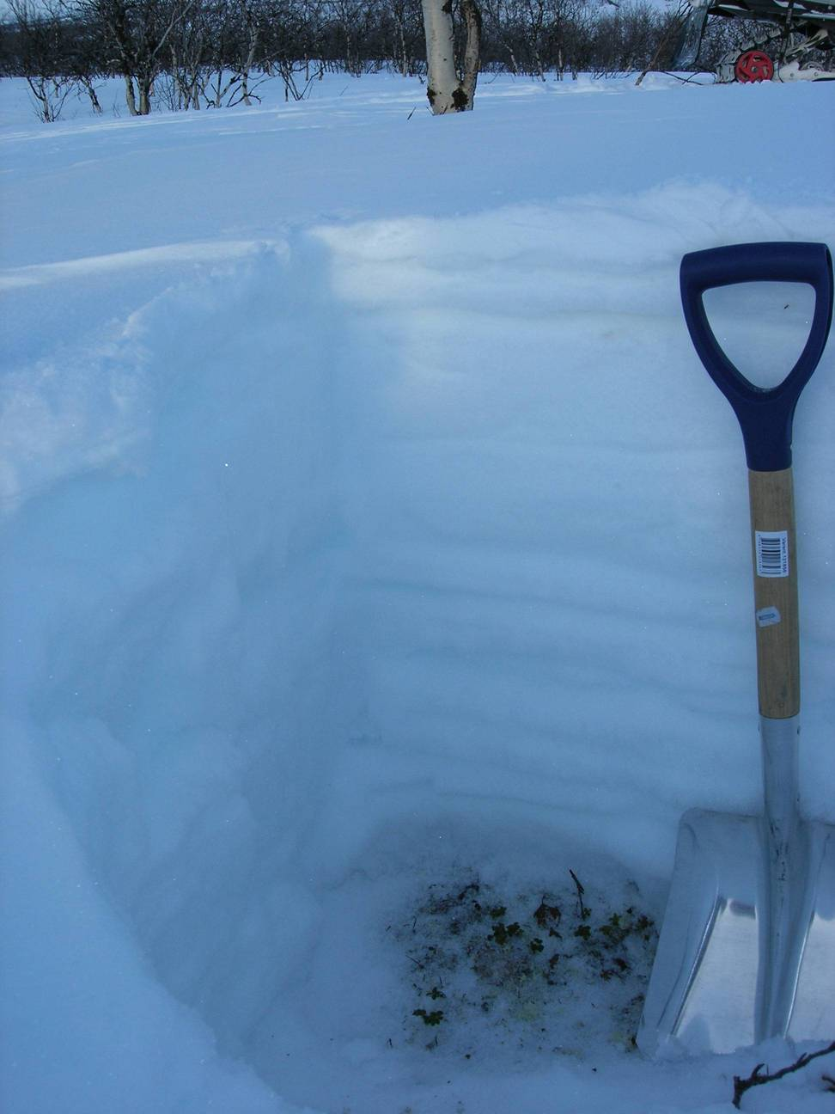
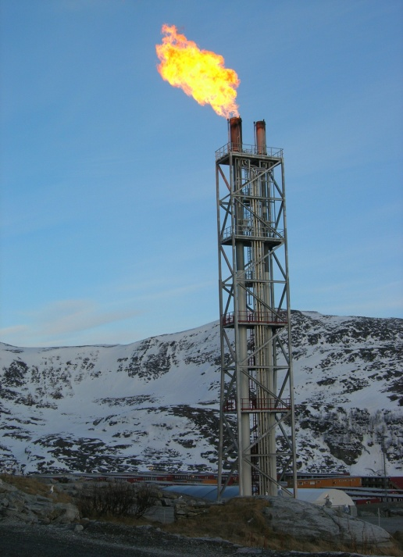
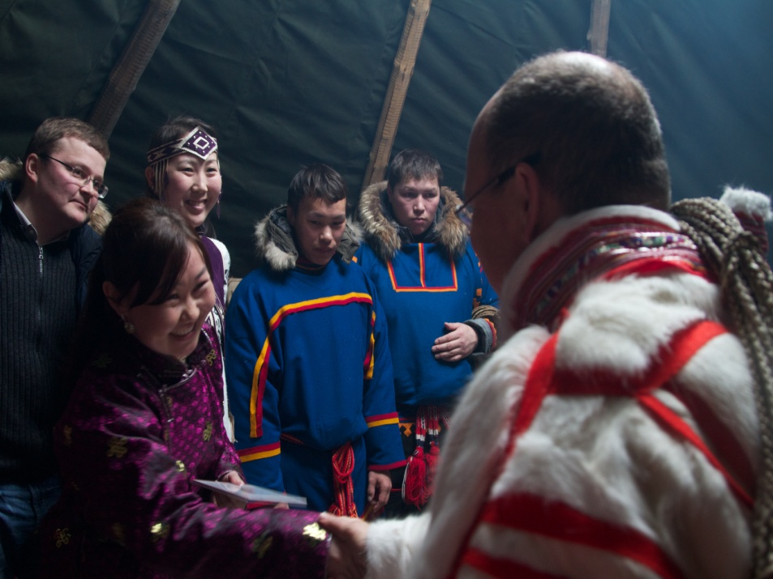
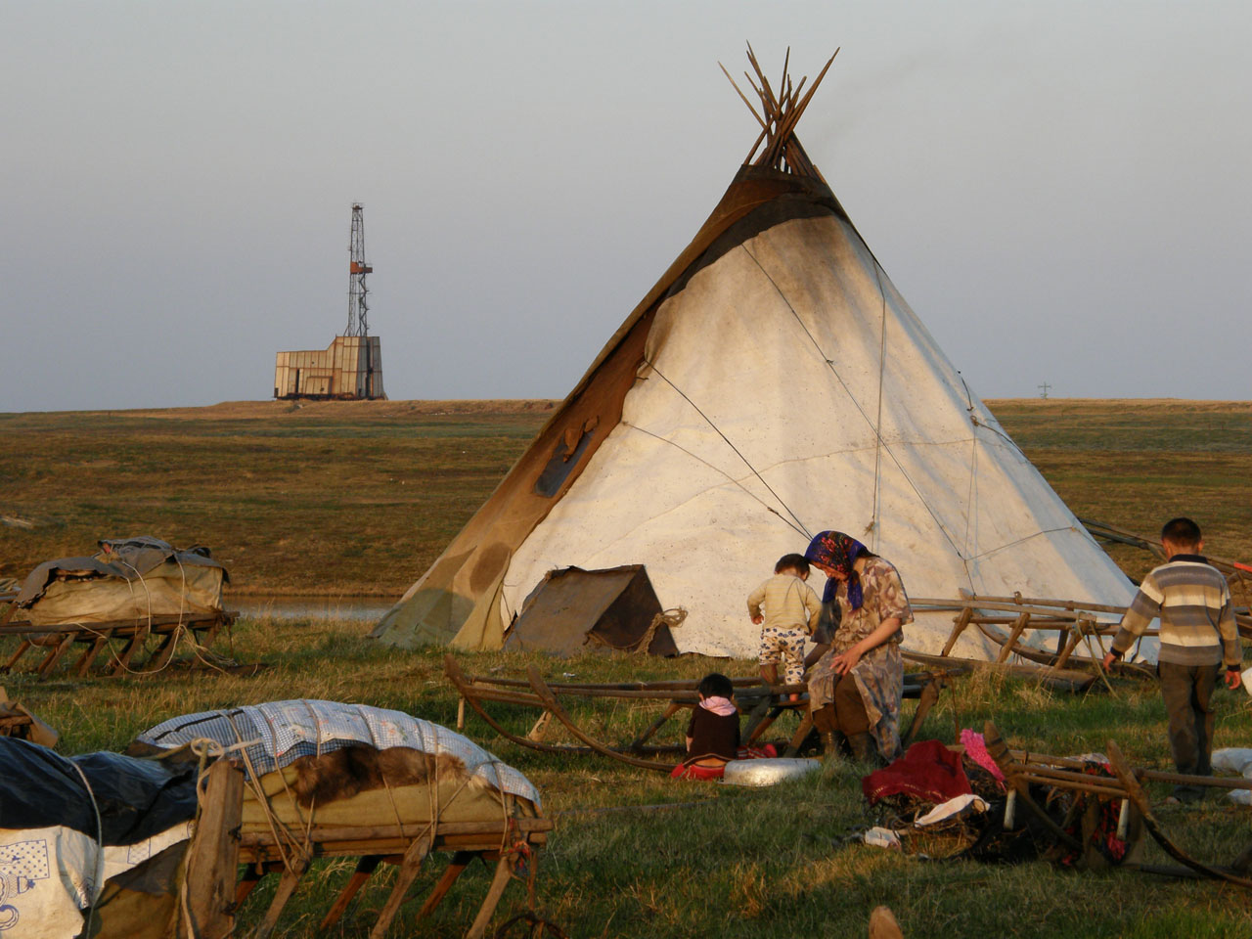
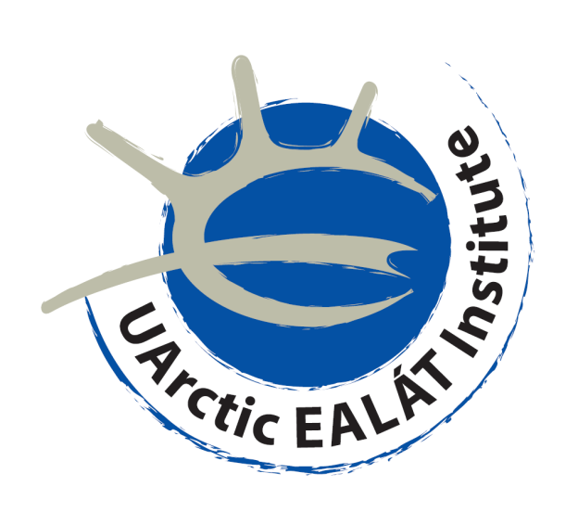
The Voice of Circumpolar Reindeer Herders: Traditional Knowledge, Adaptation to Climate Change and Land Use Change in Circumpolar Reindeer Husbandry
A. Oskal^{1,3}, M. Pogodaev^{2,3}, S.D. Mathiesen^{3,4}, P. Burgess^{1,3} (¹International Centre for Reindeer Husbandry (ICR), Norway; ²Association of World Reindeer Herders, St.Petersburg, Russia; UArctic EALÁT Institute at ICR, Kautokeino, Norway; ⁴Norwegian School of Veterinary Science, Oslo, Norway)
Indigenous peoples in the Arctic face major challenges related to changes in their society and the northern climate. More than 20 indigenous peoples are reindeer herders. There is an urgent need to better understand and inform Arctic nations both about the changes to which they are subjected and give some concrete examples how reindeer herders’ traditional knowledge can be utilized to adapt to changing conditions, including traditional use of grazing land. Local case study based workshops organized in the reindeer herding societies in the most important reindeer herding regions focussed on the local status of reindeer husbandry, climate change and land use change, and how traditional knowledge is used and how traditional grazing land are lost. Subsequently, the Arctic Council project SDWG EALÁT-Information have communicated from these community-based workshops to the Arctic Council system and its Ministerial Meetings in Norway in 2009 and Greenland in 2011. IPY/ SDWG EALÁT have promoted local competence building for indigenous peoples. The challenge of IPY/ SDWG EALÁT is to take reindeer herders’ knowledge into action for sustainable development of the Arctic and, in particular, to involve Russian and Scandinavian reindeer herders in this process. The project also had as its mandate to be the voice of reindeer herders to the Arctic Council on matters of climate change, land use change and adaptation.
Key findings
Climate and socio-economic change are now evident across the Arctic, and is particularly evident in reindeer herding cultures and in their traditional areas.
Global and regional scenarios project dramatic changes in temperature, precipitation and snow conditions in the key areas for reindeer herding and in social-economic changes for reindeer herding communities in the Arctic.
Indigenous traditional knowledge, culture, and language provide a central foundation for adaptation and building resilience to the rapid changes in the Arctic. Reindeer herding cultures and traditional knowledge are nested within and inevitably affected by institutional governance, economic conditions and other regulatory practices and conditions.
Both scientific and traditional experience-based knowledge, knowledge transformation, education and training of future leaders and others are key factors for the future sustainability of reindeer herders’ societies and their adaptation.
5. Degradation of pasture lands combined with the consequences of a changing climate present substantial challenges to the future of reindeer husbandry.
6. Engaging reindeer herding youth directly in herding practices and providing enhanced education is a key factor in the future sustainability of reindeer husbandry and its cultural foundations.
7. A future of a self-sustained and adaptive reindeer community in the circumpolar north is increasingly faced with rapid climate change, regulatory challenges, and altered or degraded pasture lands. The future for these communities is dependent on reindeer herders’ use of traditional knowledge and integrating scientific knowledge in understandings of spreading risk through diversity in social organization, economy and through understanding biological diversity.
8. The reindeer husbandry communities of the Circumpolar north are guided by three cultural constructs within which they seek to: (1) Control their own destiny, (2) Maintaining their cultural identity, and (3) Be able to live close to and rely on nature for their livelihood and well-being.
Reindeer Husbandry has a Long History in the Arctic
More than 20 different indigenous peoples in the Arctic who are reindeer herders
Reindeer/caribou are the very core of the traditional subsistence economy and culture for many indigenous northern peoples across the Arctic
Reindeer herding is practiced in Norway, Sweden, Finland, Russia, Mongolia, China, Alaska, Canada and Greenland.
Close to 100,000 herders and about 2.5 million semi-domesticated reindeer, which graze about 4 million square kilometers in Eurasia.
Reindeer husbandry organization is remarkably similar everywhere, consisting of a nomadic livelihood with family-based working communities and a typical indigenous way of life.
Reindeer herders have managed extremes in climate across vast barren circumpolar areas of land, and accumulated invaluable traditional knowledge for adaptation and survival.
Reindeer herding represents a model of management of the barren Arctic and Sub-Arctic areas, developed through generations, and under diverse natural conditions.
Reindeer herding as a nomadic indigenous livelihood has kept a continuity of cultures and knowledge in the small Arctic reindeer herding communities from time immemorial, largely independent of major shifts and changes in the rest of the world.
**********************
In recent years, Arctic reindeer herders increasingly face unprecedented challenges, such as accelerated climate change and loss of grazing land due to rapidly increasing human and industrial development in the north.
SDWG EALÁT-Information: Reindeer Husbandry, Traditional Knowledge and Adaptation to Climate Change and Loss of Pastures was a part of IPY EALÁT Network Study (IPY#399). SDWG EALÁT-Information was an Arctic Council project initiated by the Arctic Council Regular Observer Organisation Association of World Reindeer Herders (WRH) and International Centre for Reindeer Husbandry (ICR), while it was hosted in the Arctic Council by Norway. The project ran from 2007 to 2011, and was funded by, among others, the Norwegian Ministry of Foreign Affairs (main contributor), Nordic Council of Ministers, The Research Council of Norway, The Sámi Parliament of Sweden, the Finnish Ministry of Foreign Affairs, Yamalo-Nenets Autonomous Okrug, Sakha (Yakutia) Republic, the Norwegian Ministry of Reform and Government Administration, and International Centre for Reindeer Husbandry. The project has also been supported by UArctic and Arctic Portal, Iceland.
EALÁT Deliverables to the Arctic Council Ministerial Meetings in 2009 and 2011
Circumpolar Reindeer Husbandry – Areas and Peoples
IPY EALÁT Network Study - Reindeer Husbandry in a Changing Climate
Today, major challenges for circumpolar reindeer husbandry have emerged:
Climate change and rapid development are increasingly creating major changes in the physical environment, ecology, and cultures of Arctic indigenous reindeer herders
Climate changes are occurring significantly faster in the Arctic than the rest of the globe, with correspondingly dramatic impacts.
In response to these changes, the Association of World Reindeer Herders initiated IPY EALÁT Network Study:
IPY EALAT Network Study is an international, interdisciplinary collaboration with scientists through the International Polar Year (IPY) EALAT Consortium (IPY Project # 399 “EALAT, Reindeer Pastoralism in a Changing Climate”), addressing the reindeer herders’ need for additional information and knowledge for responding to the global and environmental changes through a variety of different projects, processes and activities.
IPY EALÁT Network Study and the EALÁT Consortium have been seeking to
develop local adaptation strategies and tools based upon reindeer herders’ traditional knowledge
create extensive collaboration and co-production of knowledge in a partnership between science and herders
document indigenous / traditional knowledge
define constraints and opportunities for adaptation, including institutional barriers
focus on the resilience of reindeer herding and reindeer herding communities
facilitate knowledge exchange among reindeer herders and reindeer peoples from different regions
stimulate capacity building in northern indigenous communities
help minimize the impacts of the various changes and support a sustainable reindeer husbandry in the Arctic
The EALAT initiative was conceived by indigenous reindeer herders themselves, and also represents an important
voice from the indigenous peoples of the North on Arctic change
Examples of local reindeer herders’ adaptation strategies based on traditional knowledge:
“Ealát” is a word from the indigenous Sámi language, meaning “good pasture” or “good pasture conditions”, or “something to live on” (also reflecting the dimension of reindeer’s access to food through snowlayers). It is related to the word “eallu”, meaning “[reindeer] herd”. Both these two words stems from the Sámi word “eallin”, meaning “life”.
In other words, the pasture is the foundation for the reindeer herd, and the reindeer herd is the foundation for the lives of the reindeer herding peoples.
Statistical downscaling of annual mean temperature in Karasjok, →
Norway. (The figure is showing year 1900-2100.) Based upon 11 global models under IPCC Scenario A1B. GCMs from PCMDI database for IPCC 4AR (SRES A1b/20C). IPY EALÁT/ met.no (Benestad, 2005). →
IPY EALÁT Legacies and outcomes, examples
UArctic EALÁT Institute – A continuation of the IPY institutional networks and EALÁT efforst in a new virtual institute addressing knowledge challenges of circumpolar reindeer herding
www.reindeerportal.org – A webportal containing IPY results and relevant information on circumpolar reindeer herding, including a module for web-based education
Courses developed (Bachelor, Master and PhD level). Educating 6 PhDs, 8 Master degrees, 30+ Bachelors, from reindeer herding backgrounds
Arctic Council endorsement of a follow-up project SDWG EALLIN Reindeer Herding Youth
Establishment of 4 new local reindeer herding centers in Siberia, funded by Russian Authorities
Naming of “EALÁT Street” in Khatystyr village, Sakha Republic, Russia, linked to the building of new seasonal houses for reindeer herders following SDWG EALÁT efforts in the region
Methodology and contents of IPY EALÁT Network Study
The methodology and content of IPY EALÁT Network Study includes a variety of different components:
A multidisciplinary, multicultural study
Co-production of new knowledge, involving reindeer herders into the entire process
Combination/ integration of science and traditional knowledge
Community-based workshops, place-based approach
Field studies, in close collaboration with local reindeer herding communities and organisations
Comparative studies of several reindeer herding regions
Exchange of reindeer herders, researchers, knowledge, experience and understanding between different reindeer herding regions
Statistical downscaling and modeling of climate data from all circumpolar reindeer herding regions involved
Remote sensing of Arctic change, satellite imagery
Research-based education – “Learning by herding”, online education
Top left: Top middle: Top right:
Nenets herders’ traditional castration Evenki herders utilize special lichen Chukchi herders have created their own
of reindeer, providing herds that are more found on trees if snow conditions reindeer breed adapted to the relatively extreme
robust versus ice layers in the snow etc. in the taiga grow difficult weather and natural conditions of their region
Bottom left: Bottom middle: Bottom right:
Even and Evenki herders burn special types Evenki herders’ traditional food Nenets herders utilize river valleys and lakes in
of moss to relieve insect harassment during culture could provide potential for combination with wind to relieve insect
warm summer days local value added from markets harassment during warm summer days
emerging from development
The major challenges of climate change and changed use of the Arctic are interrelated. Furthermore, they come on top of every other challenge faced by circumpolar indigenous reindeer herding communities.
“…We parliamentarians strongly believe the impact of climate change to be a matter of urgency. The climate change already has a strong impact on the living conditions of the Arctic indigenous peoples. And, if the ice disappears for large parts of the year, we will see an explosion in human activities in the Arctic. We need to find ways to regulate this activity and keep ahead of the development.”
Mrs. Hill Marta Solberg, Chair of the Standing Committee of Parliamentarians in the Arctic, Arctic Council Ministerial Meeting, Salekhard, Russia, October 2006.
Pics by ICR/ EALÁT/ P.Burgess, A.Oskal, S.D.Mathiesen, J.M.Turi, A.Degteva, E.I.Turi, A. Kuitsky, G.Nakhodkin, R.Pravettoni and S. Skaltje.
University of the Arctic EALÁT Institute
for Circumpolar Reindeer Husbandry
Graphics by ICR/ EALÁT, IPCC, NASA and IPY EALÁT/ Norwegian Meteorological Institute.

