Slide 1



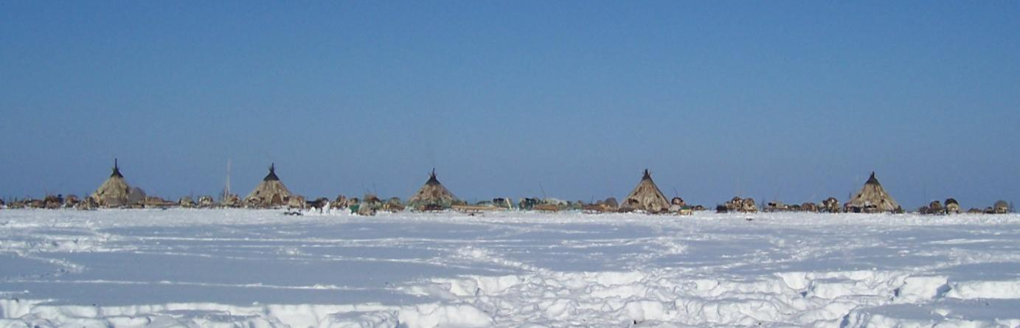
A New Project Proposal for SDWG:
EALLU- Arctic Indigenous Youth, Climate Change and Food Culture
Presentation for the Sustainable Development Working Group, Whitehorse, March 1, 2015
Photo: E.I. Turi/ EALÁT, 2007
Pic: E.I Turi, IPY EALÁT, 2008

Slide 2
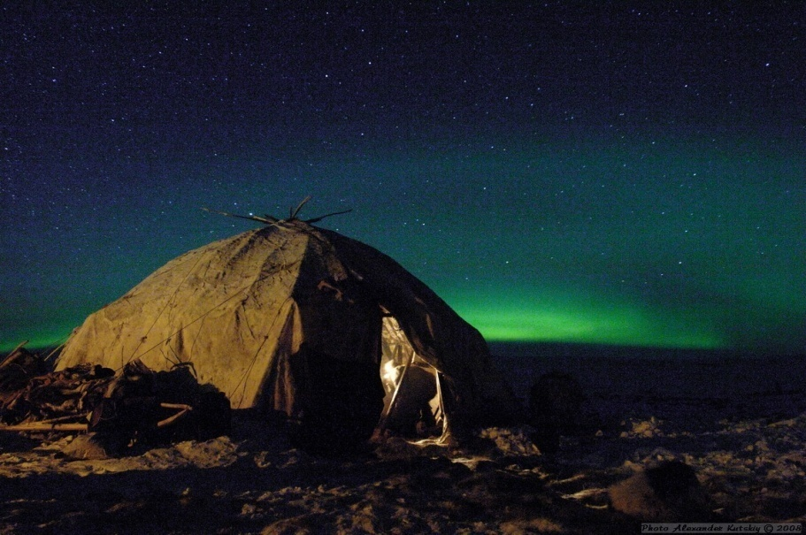
EALLU Indigenous Youth,
Climate Change & Food Culture
´Traditional Knowledge is Essential to
a Sustainable Future in the Arctic´
Pic: IPY/ SDWG EALÁT, 2008
Yaranga (tent) of Brigade nr 4, Kanchalan, 29 February 2008

Slide 3

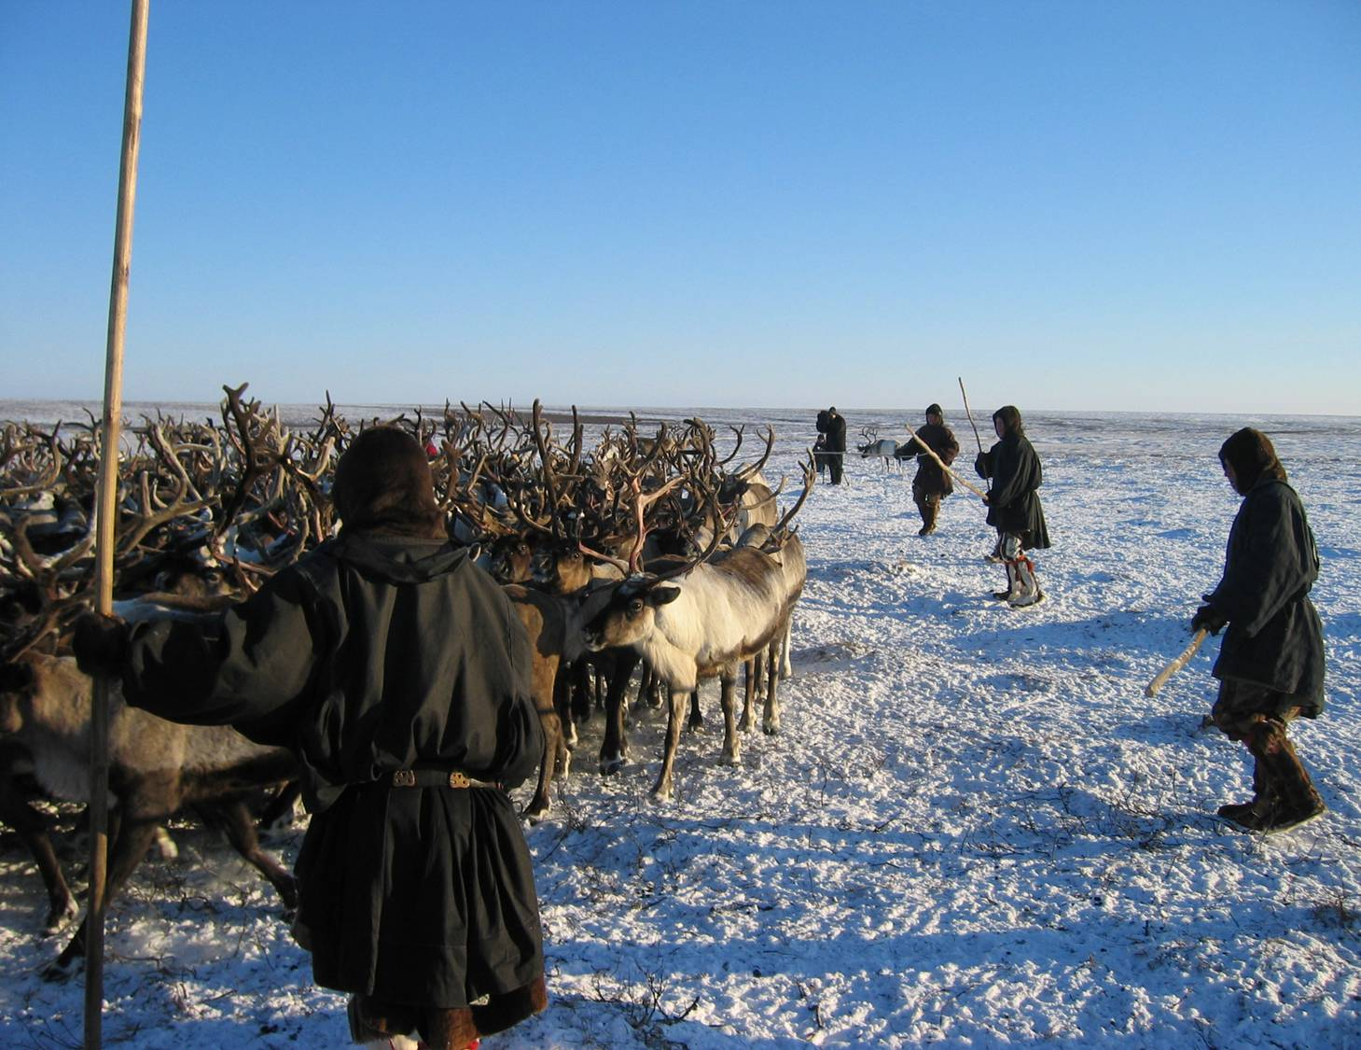
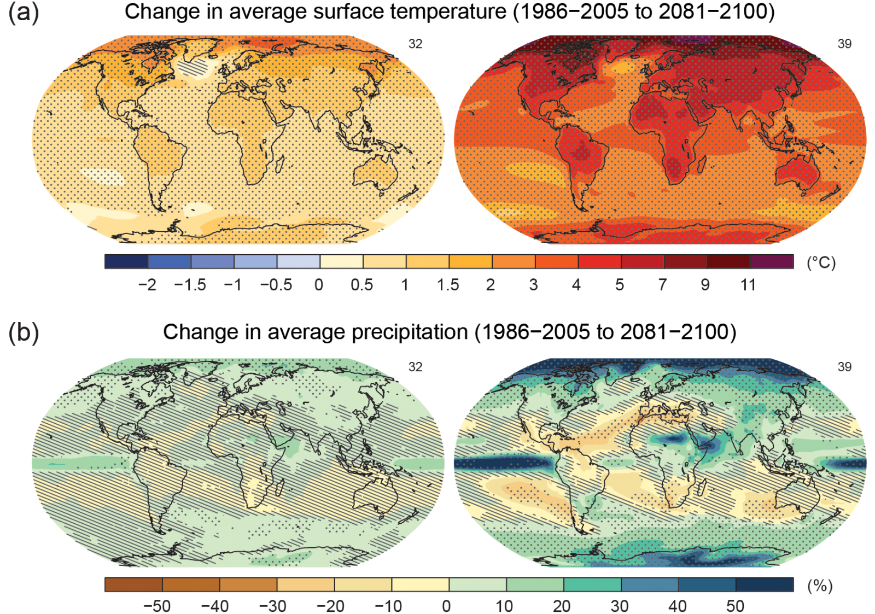
IPCC AR5 WG II - Polar Regions Chapter:
“…Complex inter-linkages between societal, economic, and political factors and climatic stresses represent unprecedented challenges for northern communities”

Slide 4

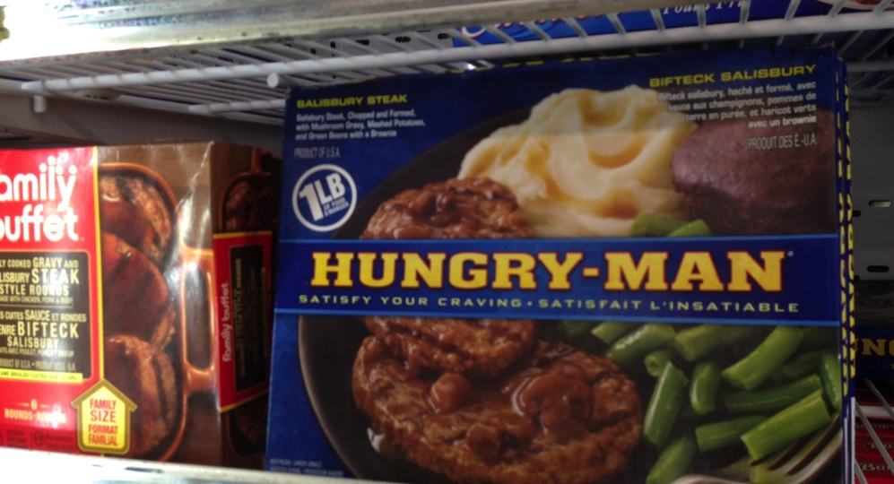
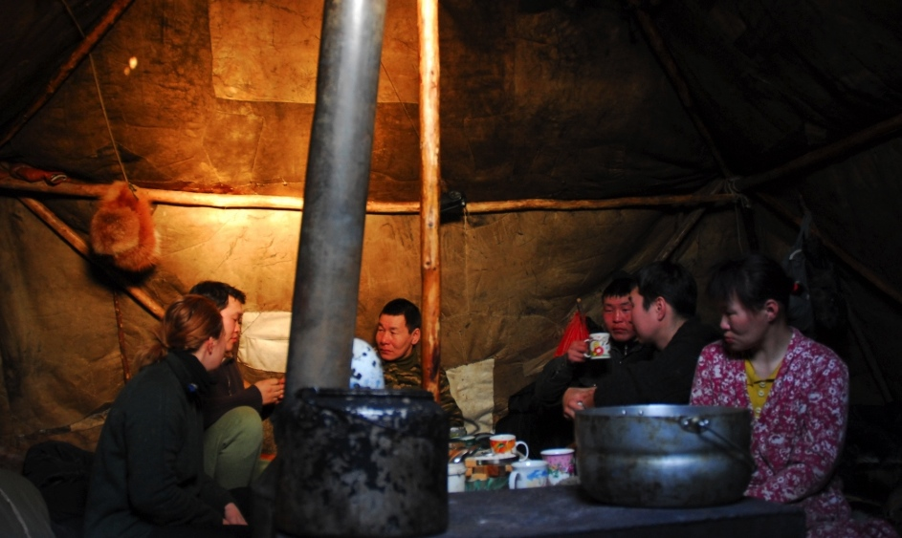
Climate change is about what we are going to eat in the future!
Daily life in Kolyma:
Reindeer herders of the Turvaurgin family
with the SDWG EALLIN team in 2012
AC Nuuk Declaration (2011):
  “…recognize that climate change and other negative factors have impacted the traditional livelihoods and food safety and security of Arctic Indigenous Peoples”.
Pics: Kia Krarup Hansen/ ICR, 2011; A.Oskal/ ICR, 2014; Coca Cola Company

Slide 5
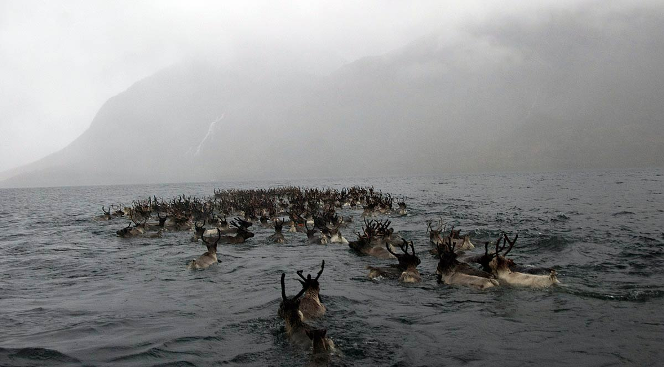
On our horizon:
Arctic Change
We need active local societies
We need engaged youth
We need competence building

Slide 6
Use the knowledge of the people to develop their own societies

Slide 7

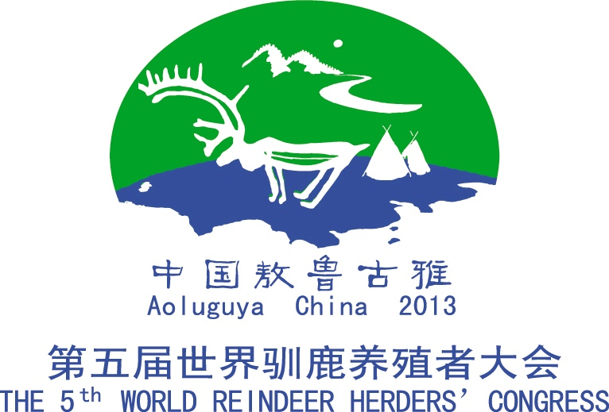
Using TK to Meet Arctic Change
The Kuellnegk Neark Declaration, on the occasion of the Saami Conference in 2013:
  “…The Saami Conference emphasizes the importance of the use of Saami traditional knowledge as a foundation for community resilience and governance of climate change.“
The Aoluguya Declaration, on the occasion of the 5th World Reindeer Herders´ Congress in 2013:
  “…Underline that well-functioning reindeer herding communities is dependent on utilizing the knowledge of the people to maintain and strengthen the well-being and resilience of their own societies.“

Slide 8
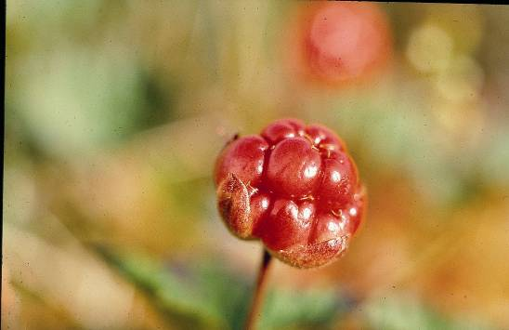
Arctic food resources
are special…
www.reindeerportal.org

Slide 9

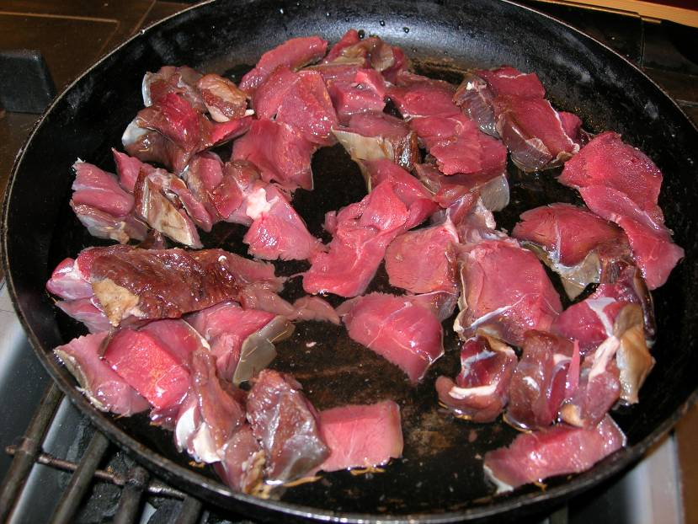
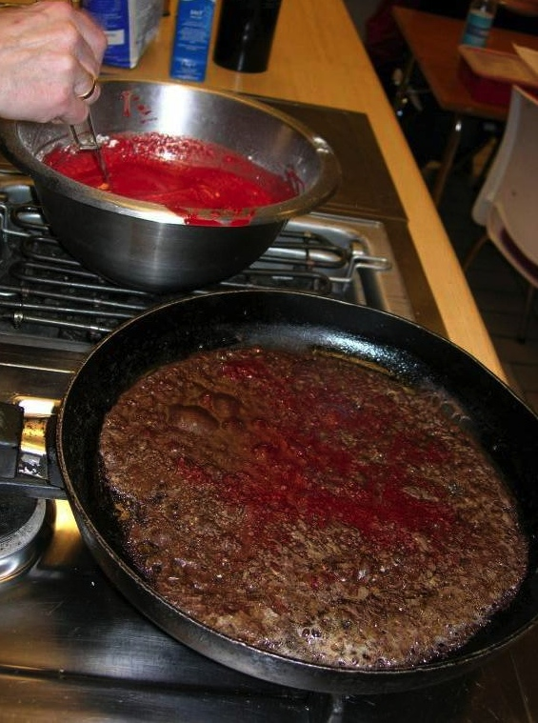
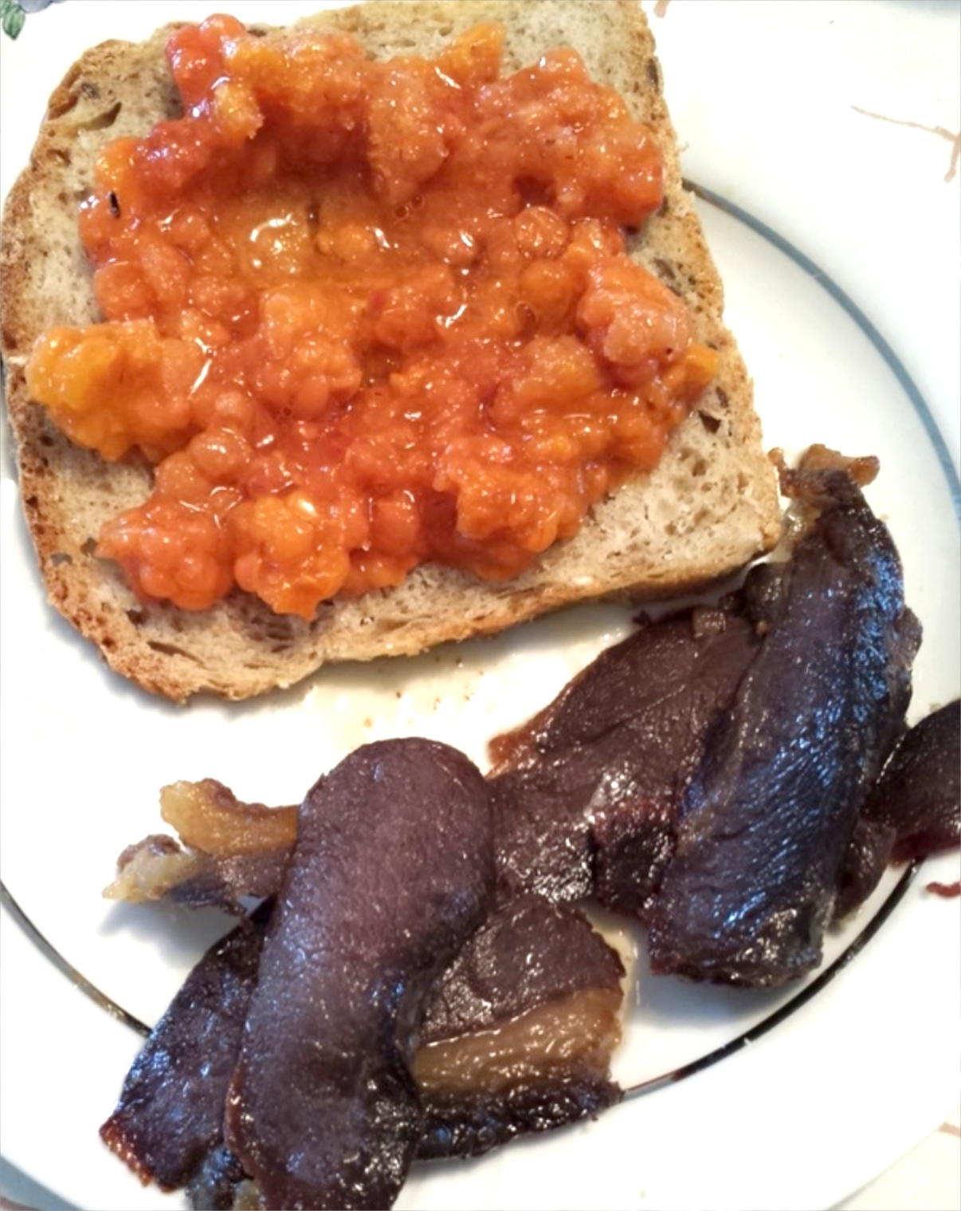
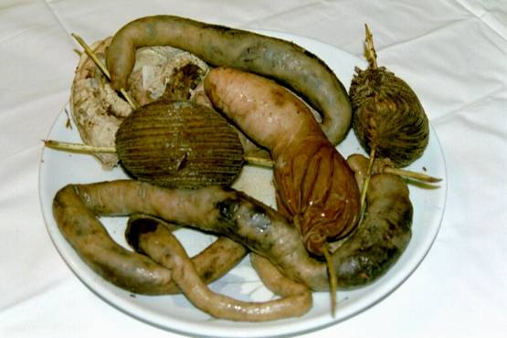
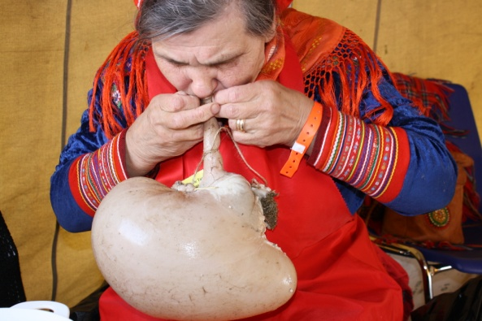
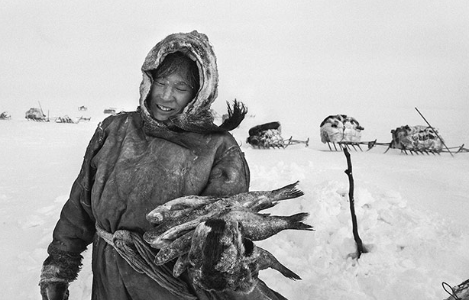
Arctic Indigenous Peoples´
Traditional Food Cultures Are Rich

Slide 10
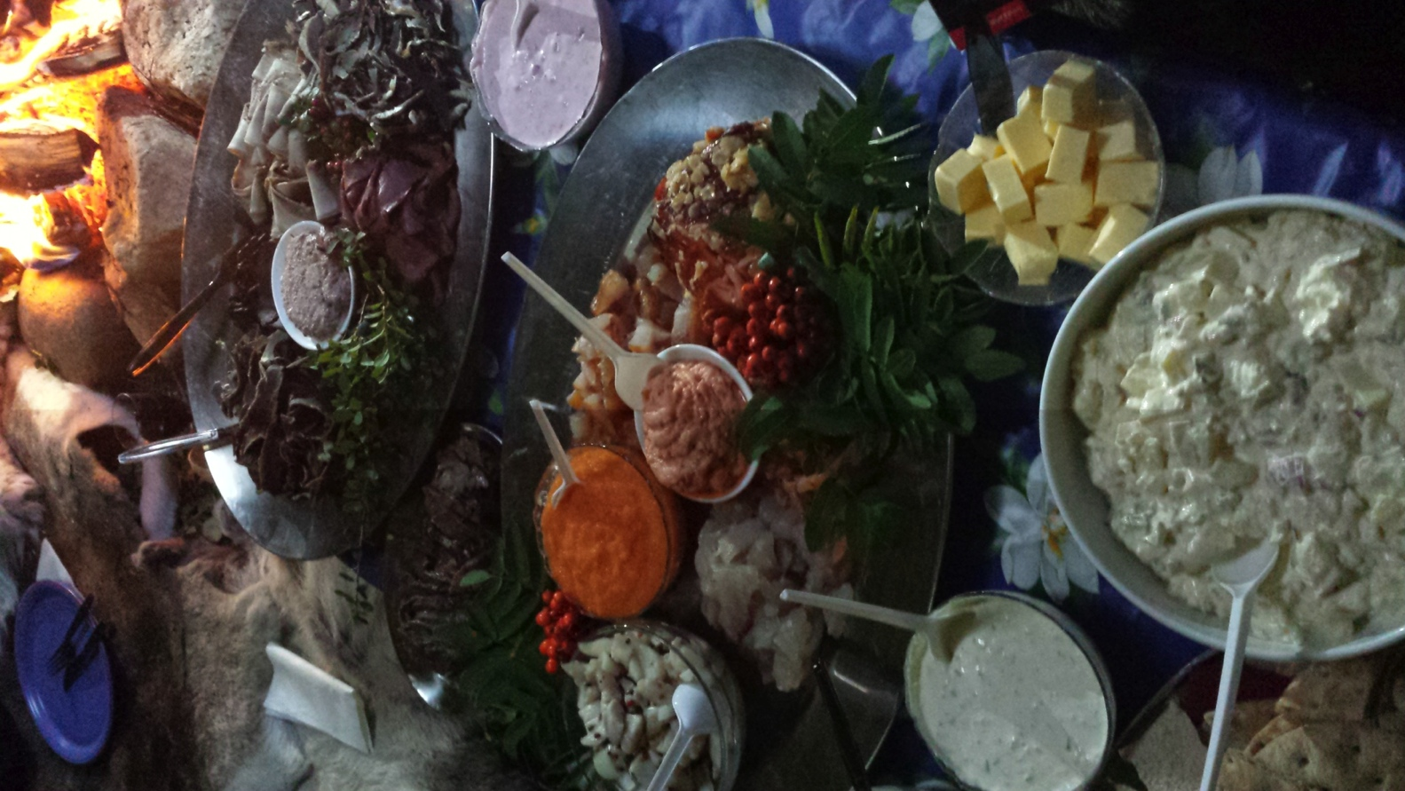
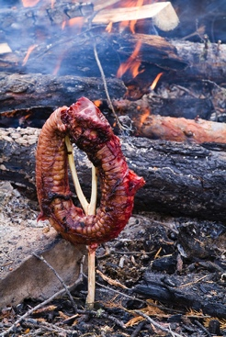
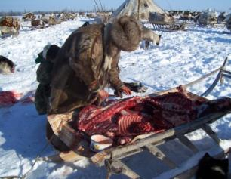
Idea
Utilizing Arctic Indigenous/ Reindeer Herding Peoples´ TK on Food and Food Resources:
A Novel Approach to Address Rapid Change

Slide 11
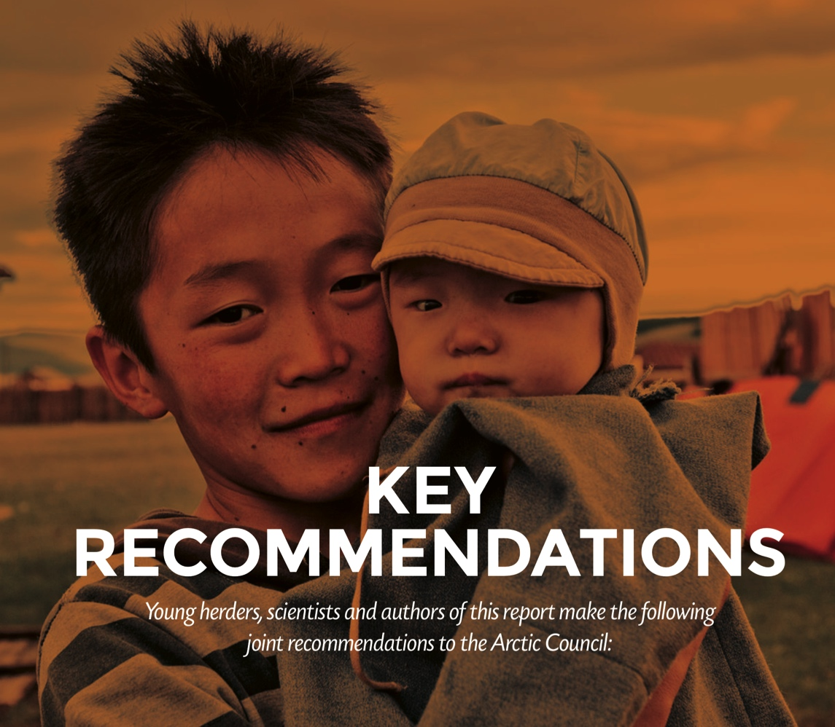
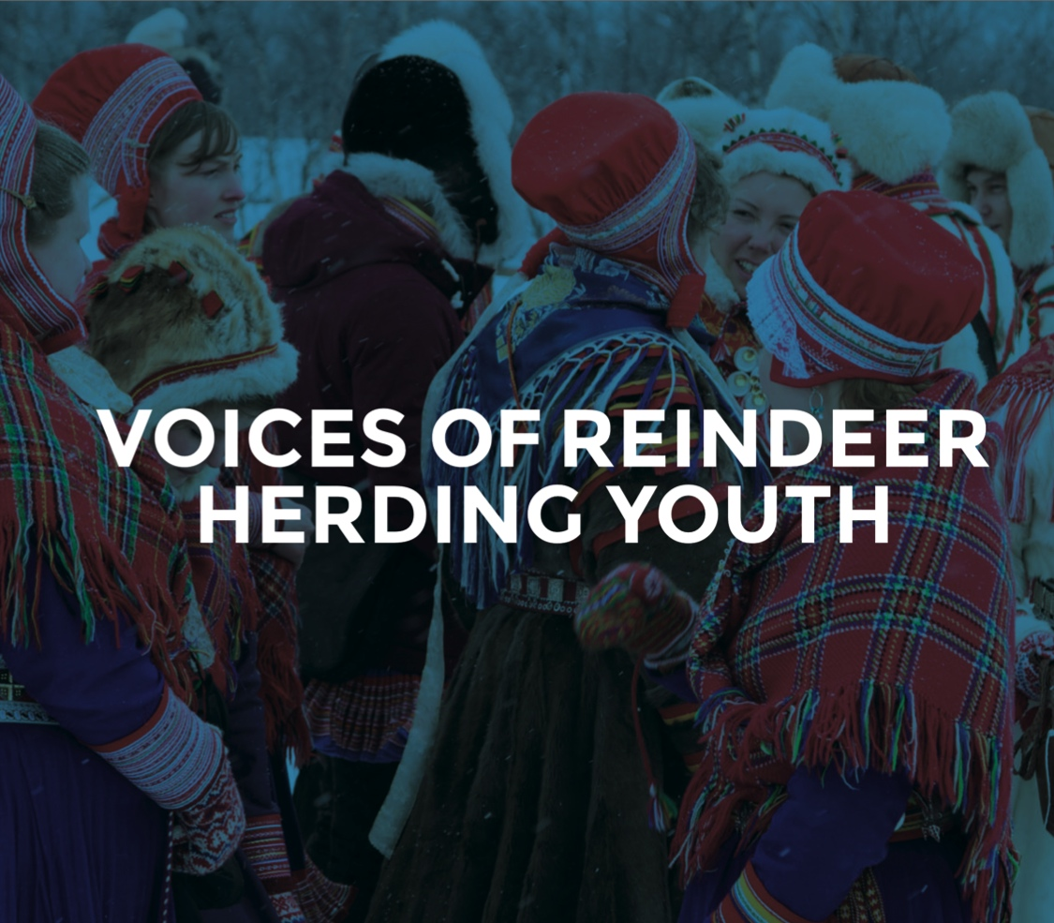
“…Create mechanisms and opportunities for young reindeer herders so that they can initiate their own added value businesses and bring new products to the market.”
SDWG EALLIN 2012-2015
“…Young reindeer herders asks that the Arctic Council and its Members support the Arctic Indigenous Peoples ́ Culinary Network Institute and UArctic EALÁT Institute, so they can deliver their relevant and culturally specific educational programs to indigenous youth.”

Slide 12
Aoluguya Declaration 2013
Декларация Аолугуйя 2013
Active Local Societies Are Key
“…Recognize the need for active local reindeer herding societies in face of the major changes that are now happening”
Economic Freedom Reduces Vulnerability
“…Recognize that the freedom of reindeer herders to develop their own economy and value added is a key factor to avoid vulnerability”
Mobilizing Diversity
“…Underline that reindeer herding also includes hunting, fishing, gathering, harvesting and other forms of nature use as integrated parts of the traditional and economic foundation,…”
Utilizing the Traditional Knowledge
“…Underline the need for documentation of biodiversity, food culture and reindeer herders´ health using traditional knowledge”

Slide 13
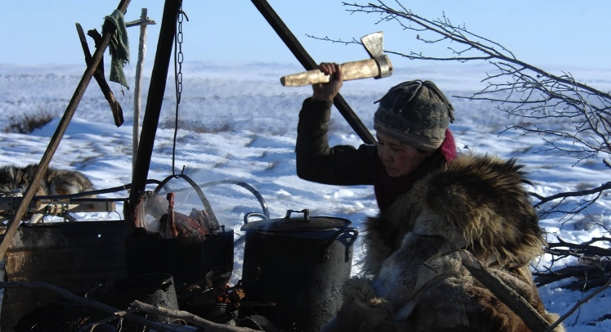
EALLU Arctic Indigenous Youth:
Traditional Knowledge and Food Culture
Navigation towards Sustainability through New Approaches for Addressing Arctic Climate Change and Globalization
Societal goal:
  A sustainable and resilient reindeer husbandry in face of climate change and globalization
Vision:
  Creating a better life for circumpolar reindeer herders
Components includes:
  Utilizing and bringing forth TK on food culture
  Local knowledge building and experience exchange
  Knowledge development
Pic: A. Kuitsky, ICR, 2008

Slide 14
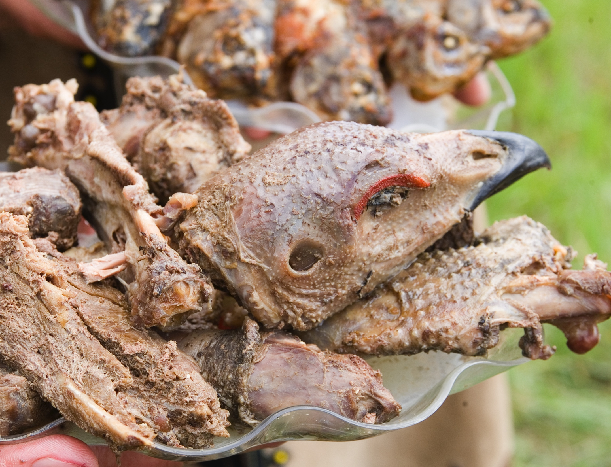
EALLU Project Activities
Pic: A. Gerasimova/ ICR, 2014
Seminars and community-based workshops
  Youth, TK and Food Culture
Stimulating and engaging indigenous youth
  People-to-people exchange
Developing and implementing training/ education courses
  Indigenous food cultures and value added
  Arctic Indigenous Peoples Culinary Institute, Partner institutions
Focus on TK on food and food cultures
  Documentation, systematization and outreach
Providing mechanisms to assist indigenous youth
  Innovation, business development, value-added

Slide 15
Arctic Indigenous Peoples´
Culinary Institute

Slide 16













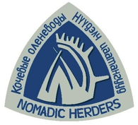



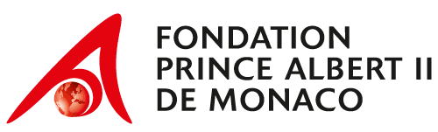
Arctic Indigenous Peoples´
Culinary Network Institute
UArctic EALÁT Institute Partners includes:
Institute for Indigenous Peoples
of the North, Herzen University,
St.Petersburg, Russia
UArctic EALÁT Institute Funders and Supporters includes:

Slide 17
Academia
Business
Scientific Knowledge
Traditional Knowledge
”Modernity”
Traditions

Slide 18
Academia
Business
´Regional Innovation System´
´Industrial Cluster´
´Triple Helix-model´
Scientific Knowledge
Traditional Knowledge
Diversification of economic structures in Arctic indigenous peoples´ areas
”Modernity”
Traditions

Slide 19
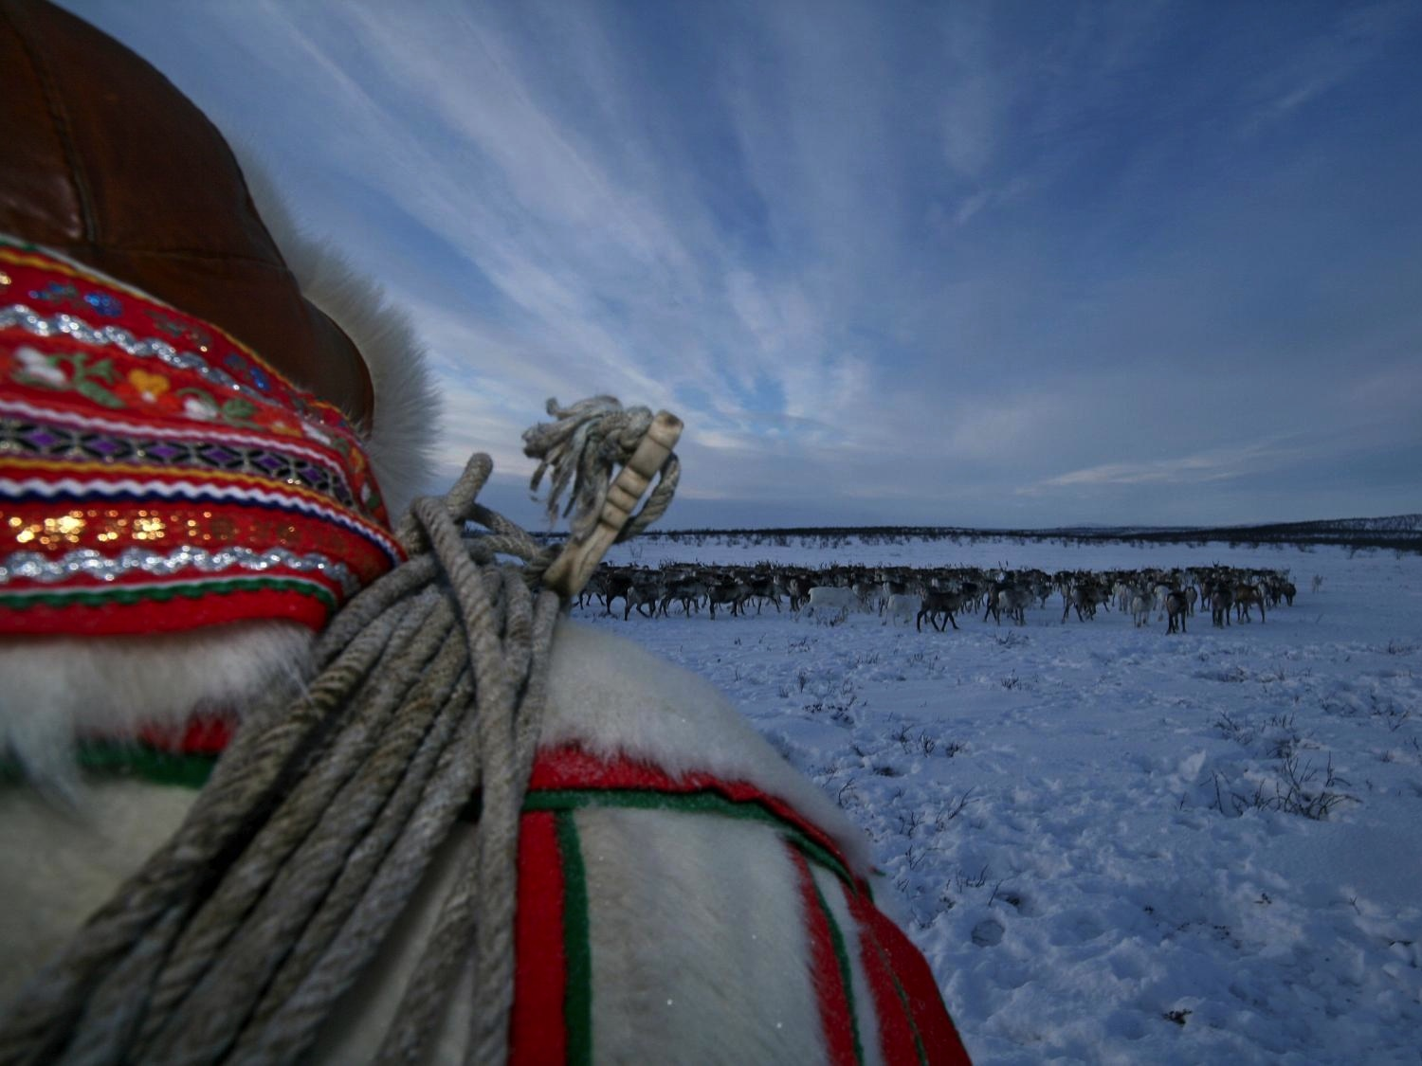
EALLU Project Outputs
Pic: JM. Gaup, 2008
Recommendations for the Arctic Council
  How to utilize TK and food cultures for sustainable development
A Circumpolar Cookbook
  Co-produced by indigenous youth and partner institutions
Training/ Education Courses
  Food culture, TK and value added, with knowledge partners
Reports
  Seminars and Community-based workshops
Different publications
  On TK and food culture

Slide 20
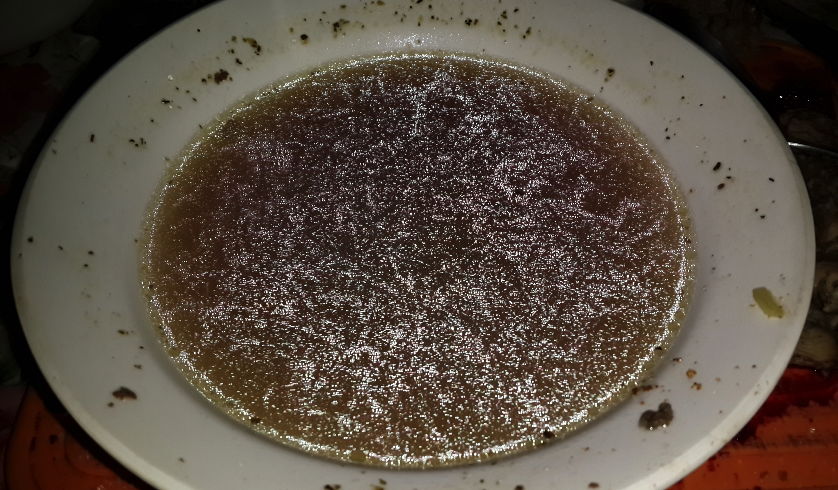
Anticipated Outcomes
Increased knowledge, understanding and cooperation in the Arctic
Improved foundations for business development and local value added
Active inclusion of Traditional Knowledge in the work of the Arctic Council
Capacity building for indigenous peoples and their societies
Pic: M. Pogodaev, ICR/ WRH, 2014

Slide 21
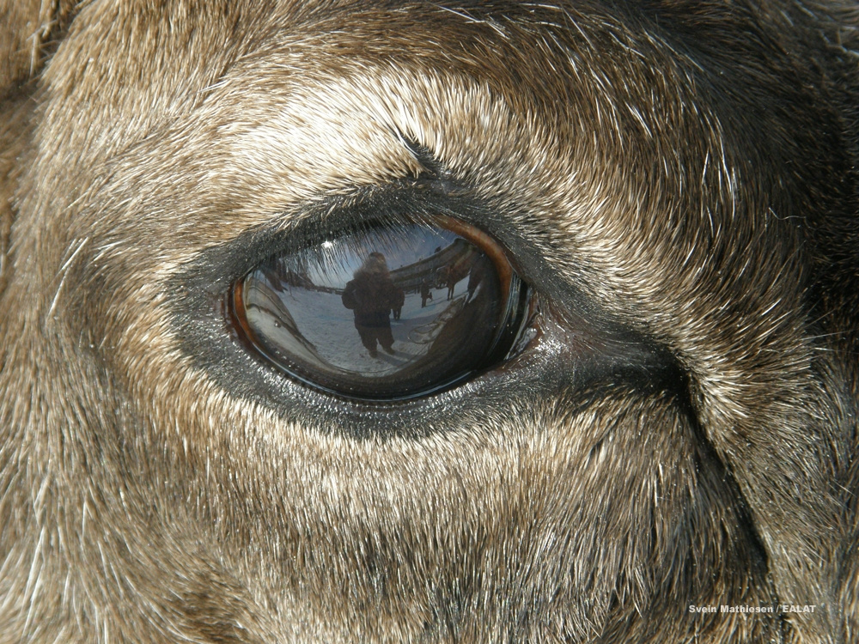
Developments
Process with States and PPs
New Institutional/ Organizational Partners
Planned Launch Event
Other issues

Slide 22
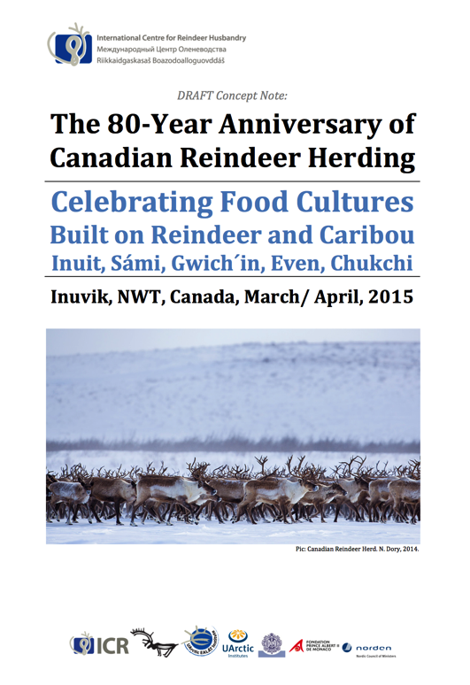
This year, reindeer herding in Canada is turning 80 years
Together with ICC, NWT Government, the Town of Inuvik and many others, we are planning an 80-Year Anniversary in Inuvik, March 27-30th
This is planned as the opening event of the EALLU project
Co-Funded by ICC, Canada (AANDC), WRH/ ICR, etc.

Slide 23

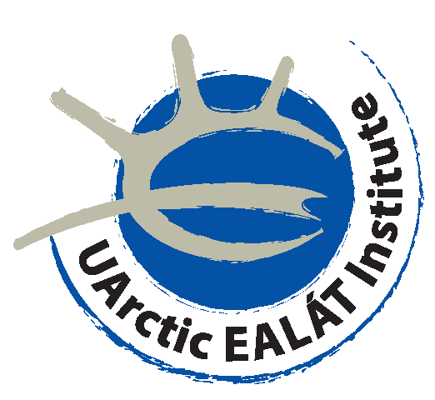
The 10-Year Anniversary of ICR
A 25-Year Celebration of the International
Collaboration of World Reindeer Herders
Reindeer Herding after the Oil Age - Opportunities in a Changing Arctic:
Food Culture, Business Development, Traditional Knowledge and Youth
September 2015
Guovdageaidnu/ Kautokeino, Norway

Slide 24
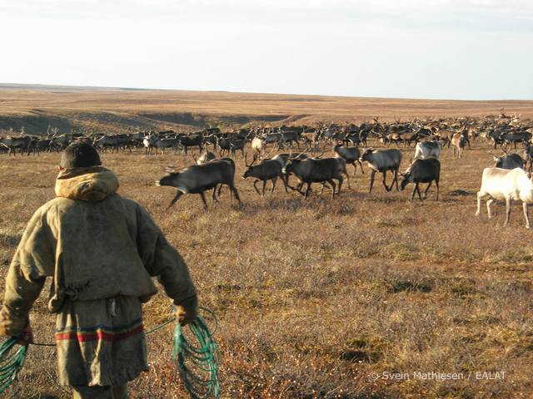
Our approach
is bottom-up
Project driven by indigenous peoples
Capacity building
´Native-to-native´ approach
Traditional knowledge
Co-production
Mobilizing diversity
Utilizing our institutional networks,
experience and indigenous youth pool
Notes:
An explosion of research, development and policy interests and agendas in the Arctic.
At the Arctic Circle in October 2016 – ten years ago

Slide 25
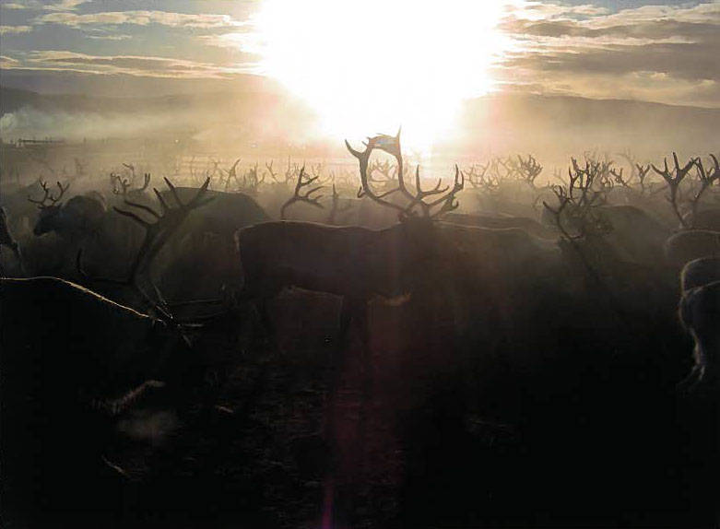
Change means both challenges and opportunities...
Change means both challenges and opportunities...
Pic: Mikkel Nils A. Sara

Slide 26
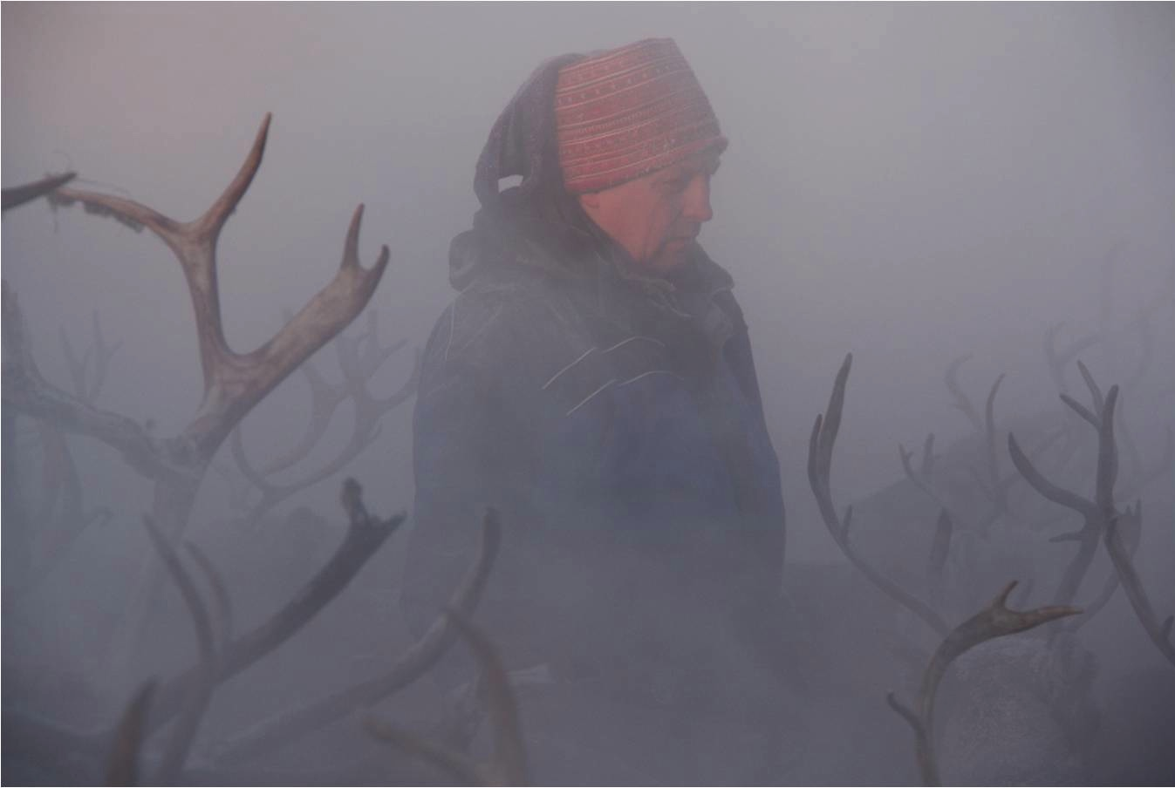
An opportunity should
be an opportunity for all

Slide 27
A New Project Proposal for SDWG:
EALLU- Arctic Indigenous Youth, Climate Change and Food Culture
Presentation for the Sustainable Development Working Group, Whitehorse, March 1, 2015
Photo: E.I. Turi/ EALÁT, 2007
Pic: E.I Turi, IPY EALÁT, 2008

